Slide 1
Visual perceptual inference in children with ASD: a motion direction estimation paradigm

Slide 2
Introduction
Autism Spectrum Disorder (ASD)
Broad range of neurodevelopmental disorders
Persistent deficits in social communication and social interaction
Restricted and repetitive behaviors
Atypical sensory processing
Long considered as an associated characteristic
90 % of children with ASD (Tomchek & Dunn, 2007)
Included a diagnostic criterion in DSM-V (American Psychiatric Association, 2013)

Slide 3
Introduction
ASD theories
Challenging!
Heterogeneous spectrum of symptoms
Higher-level social symptoms
Lower-level perceptual symptoms
Domain specific theories
Theory of Mind (Baron-Cohen, 2000) → Social symptoms
Weak Central Coherence (Happé & Frith, 2006) → Perceptual symptoms
Domain general theories
Theories based on predictive coding framework propose unifying mechanistic explanations of symptoms

Slide 4
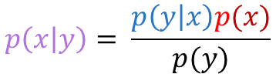

Introduction
Precision of PE
PE
Predictive coding
$$μ_{posterior}= μ_{prior}+ \frac{π_{likelihood}}{π_{prior}}(x − μ_{prior})$$
Hierarchical neurocognitive framework
Rooted in Bayesian inference
Posterior belief
Likelihood
$$p\left(x | y\right)= \frac{p\left(y | x\right)p(x)}{p(y)}$$
Prior belief

Slide 5

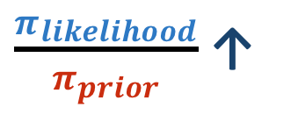
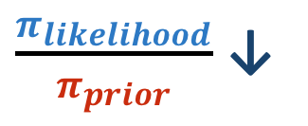
Introduction
Predictive coding
$$μ_{posterior}= μ_{prior}+ \frac{π_{likelihood}}{π_{prior}}(x − μ_{prior})$$
Hierarchical neurocognitive framework
Rooted in Bayesian inference
$\frac{π_{likelihood}}{π_{prior}}$ ↓
$\frac{π_{likelihood}}{π_{prior}}$ ↑
Posterior belief pulled towards prior belief
Posterior belief pulled towards likelihood
Notes:
So here you can see an example with a highly precise prior and a less precise likelihood. So the precision of the prediction error is low and the posterior is pulled towards the prior belief and less influenced by the new sensory data.
Here you see the oposite, a low precise prior or low confidence in our prior belief or prediction. High precision of PE, thus the updated belief or posterior distribution is pulled towards the new sensory information.

Slide 6
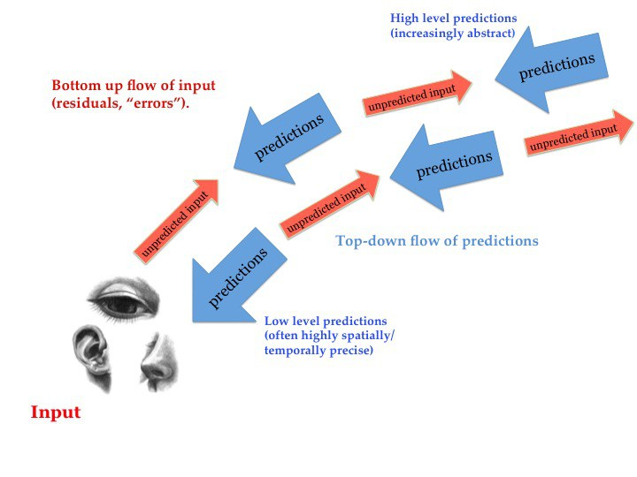
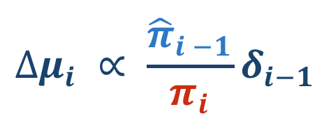
Introduction
Predictive coding
$$∆μ_{i} ∝ \frac{{\hat{π}}_{i −1}}{π_{i}}δ_{i−1}$$
(Clark, 2013)
Notes:
In predictive coding, these principles of belief updating are implemented at each level of the cortical hierarchyAt each level, predictions based on the current beliefs (i.e., priors) are compared with the bottom-up incoming signals (i.e., likelihood). Prediction errors (PEs) are computed as the difference between the top-down predictions and the bottom-up incoming signals and are fed-forward to update current representations and to shape future learning. The higher in the hierarchy, the more abstract the representations are, spanning over more time or space.
Just as in Bayesian inference, the prediction errors are weighted by the relative precision of the prediction at the level below and the precision of the current prediction.

Slide 7
Introduction
Different sources of uncertainty (Mathys et al., 2014)
Irreducible uncertainty:
Due to our noisy biological apparatus and noise in the sensory input ~ variance of the likelihood distribution
Estimation uncertainty:
Due to the probabilistic nature of the representations at each level of the cortical hierarchy ~ variance of the posterior distribution
Volatility uncertainty:
Due to changes in the structural regularities in the environment ~ volatility of the environment
Ideal observer:
High volatility: increase of precision of prediction errors: chance to learn
Low volatility or stable environment: decrease precision of prediction errors
Infer and monitor different forms of uncertainty: Flexibly adjusting the precision attributed to PEs at different levels of its hierarchy
Optimally predict the environment and to minimize PEs.
Notes:
Not all PEs are created equal: they can be due to different sources of uncertainty.
An important and challenging task for the brain is to infer and to monitor these different forms of uncertainty by flexibly adjusting the precision attributed to PEs at different levels of its hierarchy, in order to optimally predict the environment and to minimize PEs.

Slide 8
Introduction
Bayesian brain theories of ASD
Hypo-prior hypothesis (Pellicano & Burr, 2012)
High precision of likelihood hypothesis (Brock, 2012)
➔ Perception mainly driven by incoming sensory information and less biased towards prior beliefs
Notes:
Against the background of this general framework, it was first hypothesised that individuals with ASD have inprecise or flat priors by Pellicano and burr. which would result in percepts mainly driven by the incoming sensory information. As a reaction Brock proposed that a high precision of the likelihood could also be the cause of percepts mainly driven by the incoming sensory information. of individuals with ASD are mainly driven by the incoming sensory information and less biased towards the prior beliefs(Brock, 2012; Pellicano & Burr, 2012).

Slide 9
Introduction
Predictive Coding and ASD
HIPPEA: High and Inflexible Precision of Prediction Errors in ASD (Van de Cruys et al., 2014)
Importance of dynamic precision modulation
Continuous high weighting of prediction errors
➔ Independent of the context (Inflexible)
Extremely updated and narrow prediction models, often fitting irrelevant noise.
Impedes learning of broader high-level abstractions.
Aberrant inferences about volatility uncertainty (Palmer, Lawson & Hohwy, 2017)
Importance of dynamic precision modulation
Precision modulation depending on inferences about the volatility of the environment
➔ High precision of prediction errors in some contexts and too low in other contexts
Notes:
Later on, other frameworks based on predictive coding proposed unifying mechanistic explanations of the heterogeneous spectrom of symptoms presented in ASD. In our lab, Sander and colleagues proposed the HIPPEA account, for High and Inflexible precision of prediction errors

Slide 10
Objectives
Notes:
I will first start with a short introduction and then tell you more about the goals and methods of the work packages of my PhD project.

Slide 11


Objectives
➔ To understand how children with ASD implicitly build up prior distributions and how they integrate these prior distributions with sensory evidence
Under different degrees of irreducible uncertainty (i.e., sensory noise)
After a shift in the mean of the likelihood distribution
→ Update of prior distribution over time?
$${\text{σ} }_{L}$$
$${\text{σ} }_{L}$$
Notes:
The second objective is to understand how children with ASD implicitly build up prior distributions and how they integrate these prior distributions with sensory evidence

Slide 12
Method

Slide 13
Method
Participants
25 typically developing (TD) children (14 ♂, 11 ♀)
10 – 14y, M = 11.82
No intellectual disability (IQ > 70)
Normal or corrected-to-normal vision
24 children with a formal ASD diagnosis (16♂, 8 ♀)
10 – 14y, M = 12.1
No intellectual disability (IQ > 70)
Re-evaluation of ASD diagnosis within the research protocol using the Dutch version of the ADOS-2 and the SRS
→ Group-wise matched for age, gender ratio and IQ

Slide 14

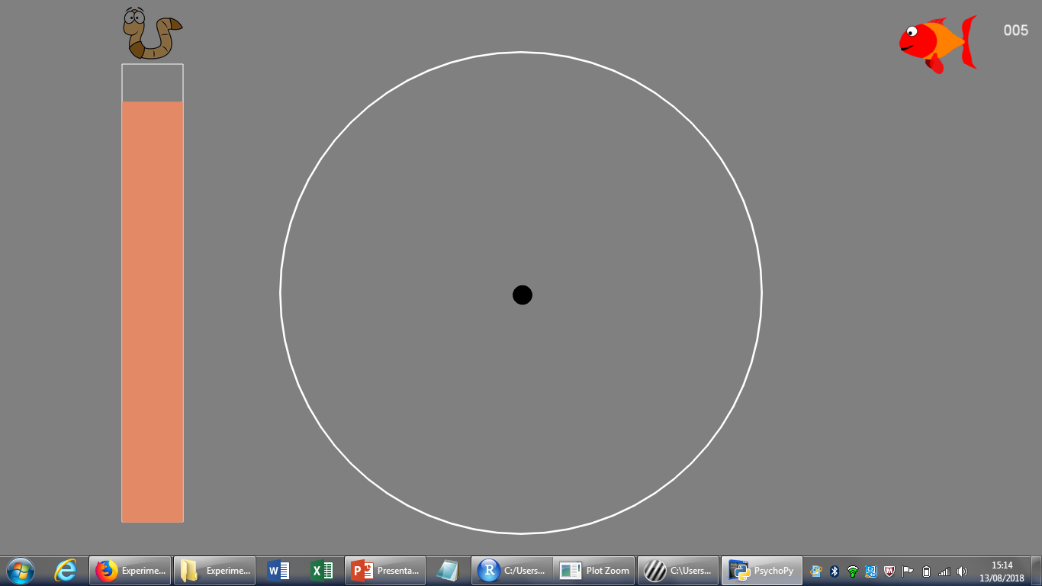
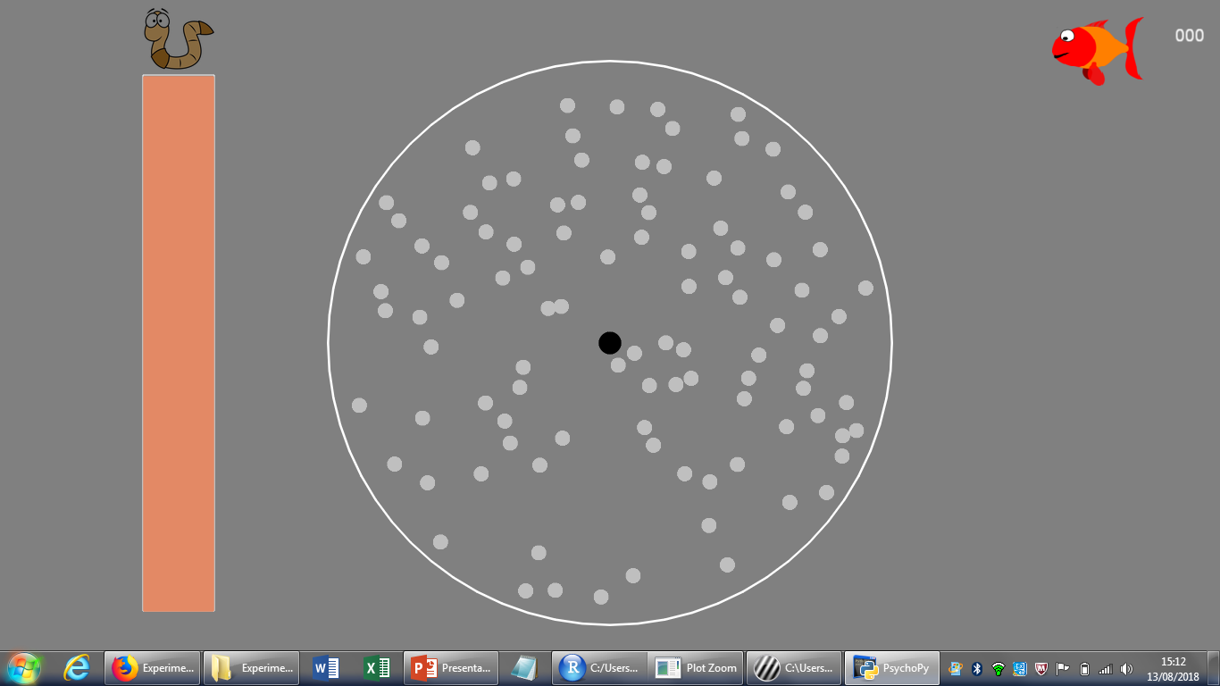
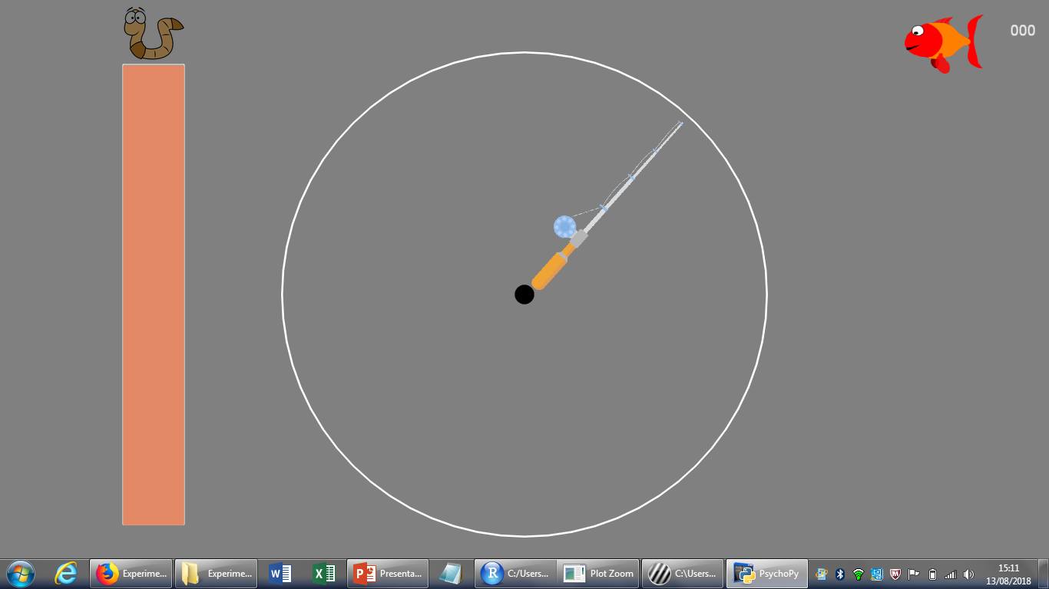

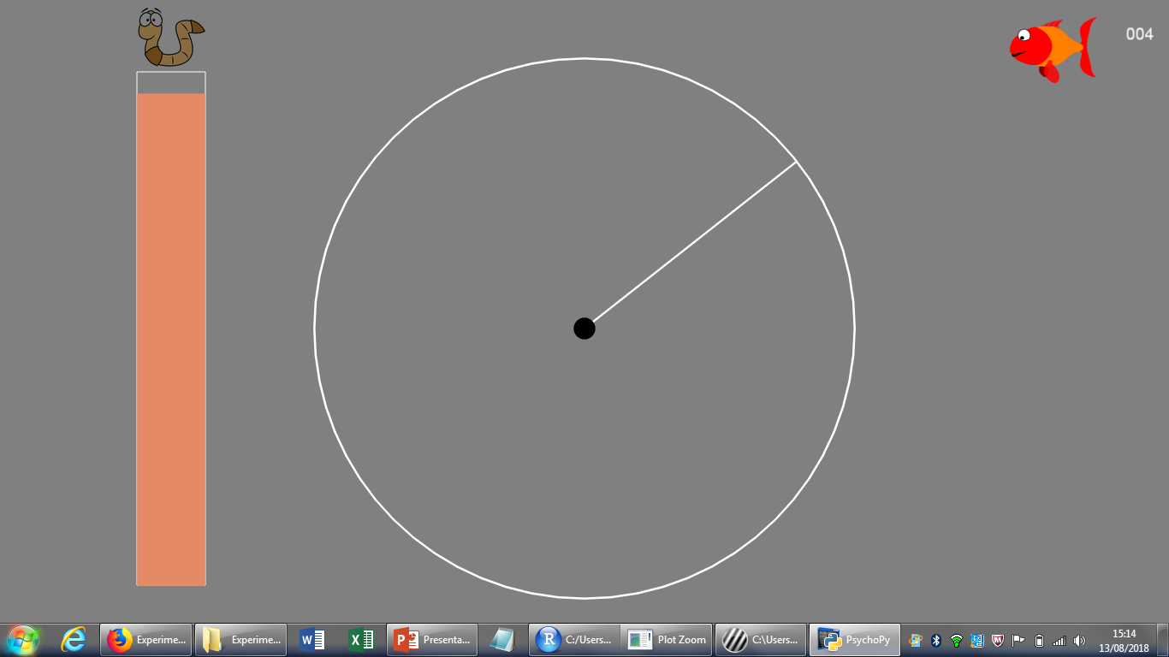
Method
Fixation
Motion
Procedure
Response
1000 ms
Global motion direction estimation task
Confirmation
600 ms
Untill response
Feedback
100 ms
100 ms

Slide 15
Method
Stimuli
A white-bordered circular aperture (15°)
A black fixation point (0.10°)
Unlimited lifetime random dot patterns
Speed: 3°/sec
Moving for 400 ms
100 white dots (diameter 0.44°)
Individual motion direction of dots sampled from Gaussian distribution (high vs. low variance)

Slide 16
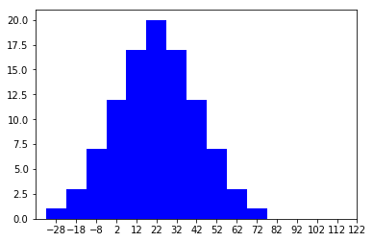
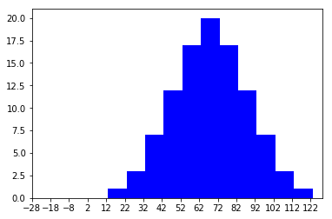
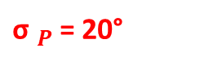
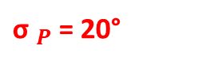
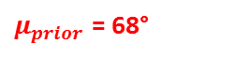
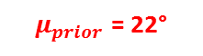
Method
Fixation
Motion
Implicit learning of a prior distribution
Response
1000 ms
4 blocks of 100 trials each
Confirmation
600 ms
3 blocks (300 trials)
1 block (100 trials)
Untill response
Feedback
Sensory evidence
Frequency
Frequency
100 ms
Average motion direction (°)
Average motion direction (°)
${\text{σ} }_{P}$ = 20°
${\text{σ} }_{P}$ = 20°
100 ms
Prior distribution
$μ_{prior}$ = 22°
$μ_{prior}$ = 68°

Slide 17

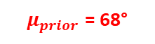
Method
Fixation
Motion
Implicit learning of a prior distribution
Response
1000 ms
4 blocks of 100 trials each
Confirmation
600 ms
3 blocks (300 trials)
1 block (100 trials)
Untill response
Feedback
Sensory evidence
Frequency
Frequency
100 ms
Average motion direction (°)
Average motion direction (°)
100 ms
Prior distribution
$μ_{prior}$ = 68°
$μ_{prior}$ = 22°

Slide 18


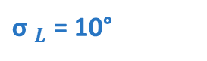
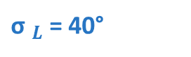
Method
Fixation
Motion
Procedure
Response
1000 ms
Manipulation of sensory uncertainty per trial:
Confirmation
High noise condition
Low noise condition
600 ms
Untill response
Feedback
100 ms
${\text{σ} }_{L}$ = 10°
${\text{σ} }_{L}$ = 40°
100 ms
$${\text{σ} }_{L}$$
$${\text{σ} }_{L}$$

Slide 19
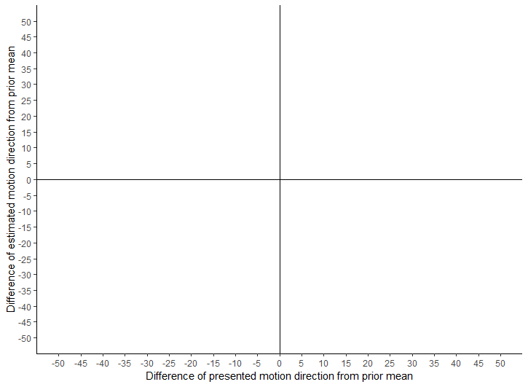

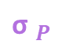


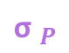

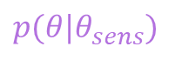
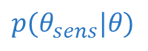

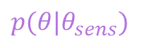
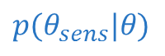

Low noise trial
Likelihood
Likelihood
Posterior
$${\text{σ} }_{P}$$
Prior
Estimated direction
$${\text{σ} }_{L}$$
$${\text{σ} }_{L}$$
$${\text{σ} }_{L}$$
Presented direction
$$p(θ_{sens}|θ)$$
$$p(θ|θ_{sens})$$
High noise trial
Likelihood
Likelihood
Posterior
Prior
Estimated direction
$${\text{σ} }_{P}$$
$${\text{σ} }_{L}$$
$${\text{σ} }_{L}$$
$${\text{σ} }_{L}$$
Presented direction
$$p(θ_{sens}|θ)$$
$$p(θ|θ_{sens})$$

Slide 20
X_{est}=σ²_{L}/(σ²_{L}+ σ²_{P})μ_{P}+σ²_{P}/(σ²_{L}+ σ²_{P})μ_{L}
The real μ_{P} = 22° or 68°
The real μ_{L} changes every trial [μ_{P} -+ 50, μ_{P} -+ 40, μ_{P} -+ 30, μ_{P} -+ 20, μ_{P} -+ 10, μ_{P} ]
Linear regression of Xest as a function of the presented motion direction
Slope = σ²_{P}/(σ²_{L}+ σ²_{P})
μ_{P}= β₀/(1- slope)
Subjects’ average reliance on likelihood vs. prior information: For the correlation between fMRI signal and individual behavior tendencies, the slopes associated with each trial type were averaged to get an estimate of an individual’s average reliance on likelihood information.

Slide 21
Questions & Predictions
Are children with ASD able to estimate the average motion direction in the noisy condition?
→ hypo-prior : ASD < TD
→HIPPEA: ASD = TD in low noise condition; ASD > TD in high noise condition ~ Manning et al. (2015)
Does prior learning happen? Are children with and without ASD biased more towards the prior distribution when there is more sensory noise?

Slide 22
Questions & Predictions
Difference in prior learning? Are children with ASD more or less biased compared to TD children in stable blocks?
→ Hypo-prior: ASD less biased compared to TD
→ HIPPEA: ASD less biased compared to TD at beginning, more biased towards the end of the stable blocks (~ more precise prior)
Dynamics of prior learning? What happens after a shift in the prior mean?
→ Hypo-prior: ASD less biased compared to TD
→ HIPPEA: Difficulties with flexibly adjusting precision of PEs → still more biased towards previous prior distribution?

Slide 23
Results

Slide 24
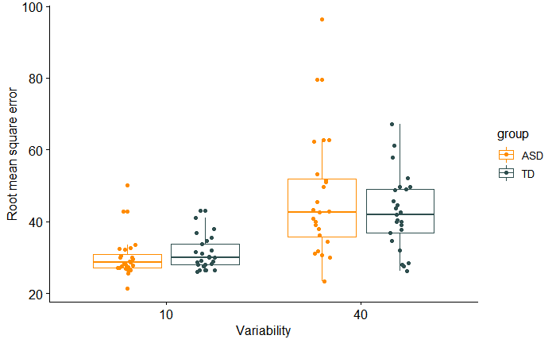
1. Overall performance
RMS error per condition per group
***

Slide 25
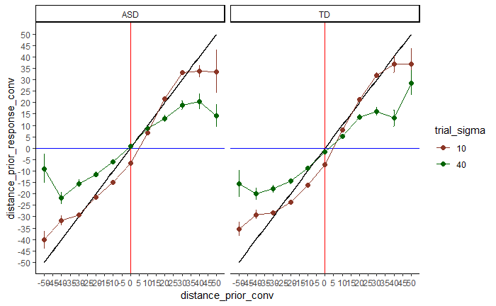
2. Bias towards prior distribution in stable blocks?
Motion direction estimates in stable blocks per condition for each group
Difference of estimated motion direction from prior mean
Difference of presented motion direction from prior mean

Slide 26
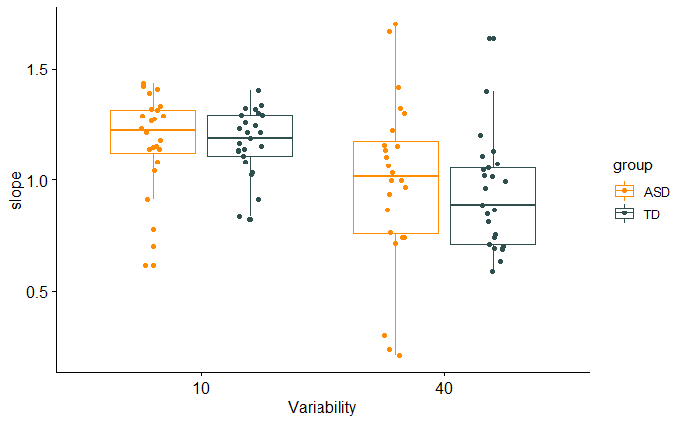
2. Bias towards prior distribution in stable blocks?
Slopes in stable blocks per condition per group
X_{est}=σ²_{L}/(σ²_{L}+ σ²_{P})μ_{P}+σ²_{P}/(σ²_{L}+ σ²_{P})μ_{L}
***
Notes:
Estimated with linear regression fits!

Slide 27
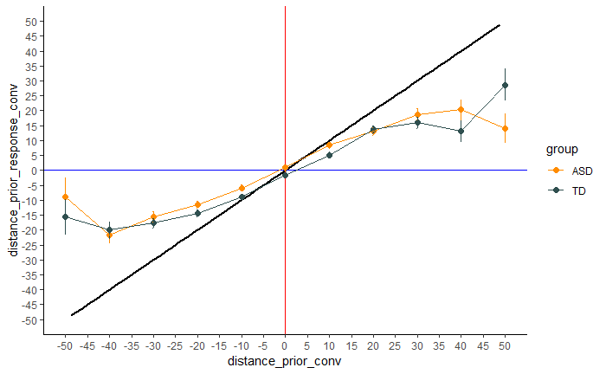
3. Children with ASD more or less biased compared to TD children?
Direction estimates in noisy condition per group
Difference of estimated motion direction from prior mean
Difference of presented motion direction from prior mean

Slide 28
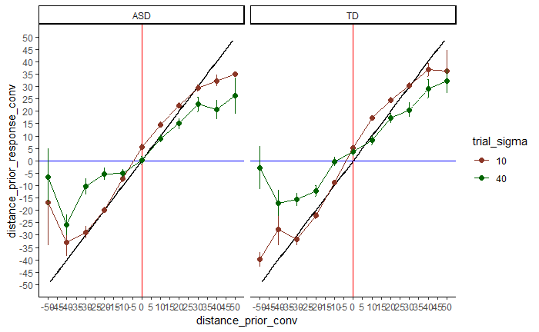
4. Dynamics?
Block 1, 2 & 3
Block 4
Difference of estimated motion direction from prior mean
Difference of estimated motion direction from prior mean
Difference of presented motion direction from prior mean
Difference of presented motion direction from prior mean

Slide 29
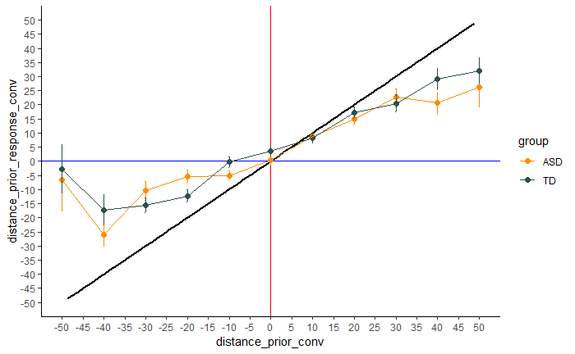
4. Dynamics?
Block 1, 2 & 3
Block 4
Difference of estimated motion direction from prior mean
Difference of estimated motion direction from prior mean
Difference of presented motion direction from prior mean
Difference of presented motion direction from prior mean

Slide 30
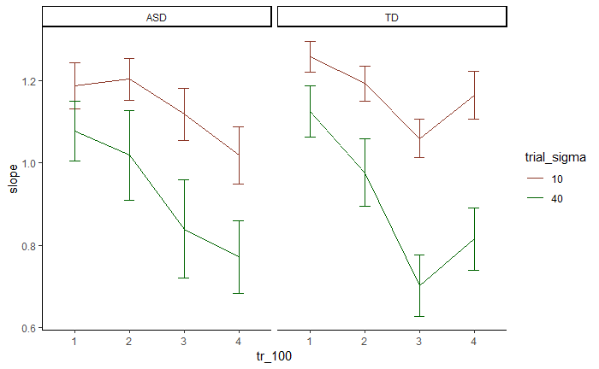
4. Dynamics?
Slope per 100 trials per condition for each group

Slide 31
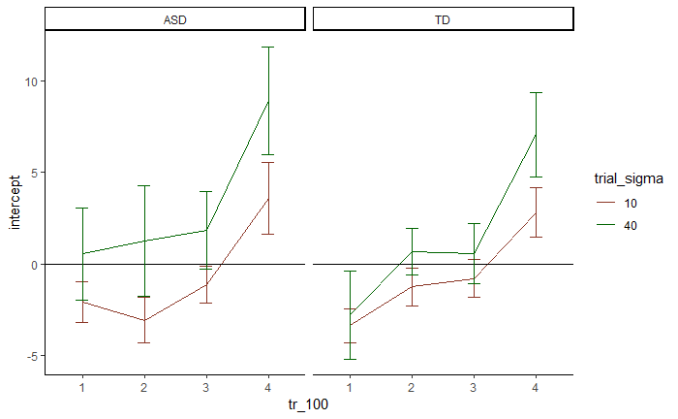
4. Dynamics?
Intercept per 100 trials per condition for each group

Slide 32
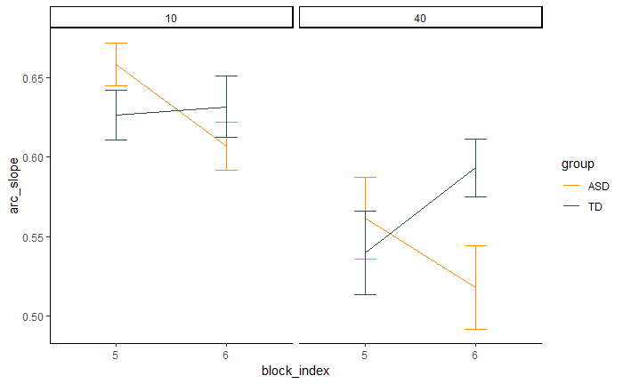
4. Dynamics?
Instantaneous Bayesian slope in last 20 trials before shift and first 20 trials after shift
Last 20
First 20
Last 20
First 20
Notes:
Instantaneous Bayesian Slope
X_{est}=(1 - s )μ_{P}+ s μ_{L} (2)
Which gives us the slope per trial :
s = (X_{est} -μ_{P} )/(μ_{L} -μ_{P} ) (3)
Significant main effect of variability
Significant group x variability interaction effect

Slide 33
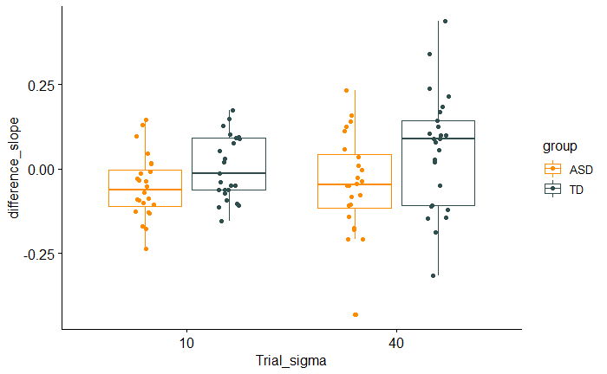
4. Dynamics?
Difference in slope between last 20 trials and first 20 trials per condition per group

Slide 34
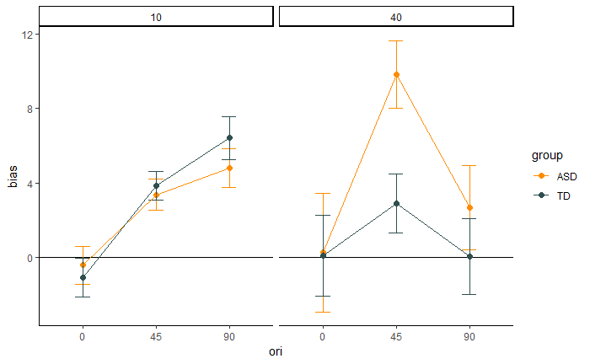
2. Structural priors?

Slide 35
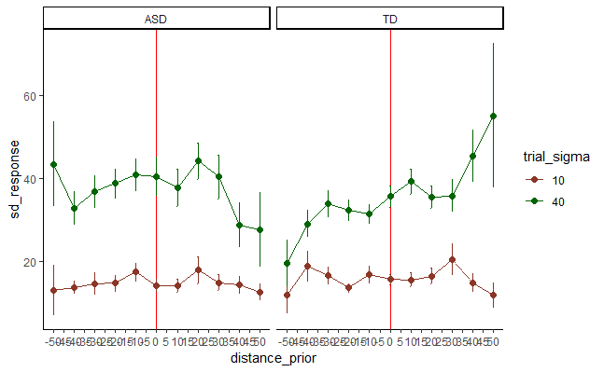

Slide 36
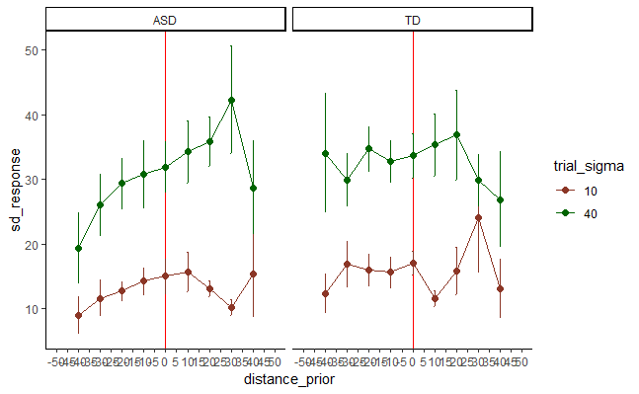

Slide 37
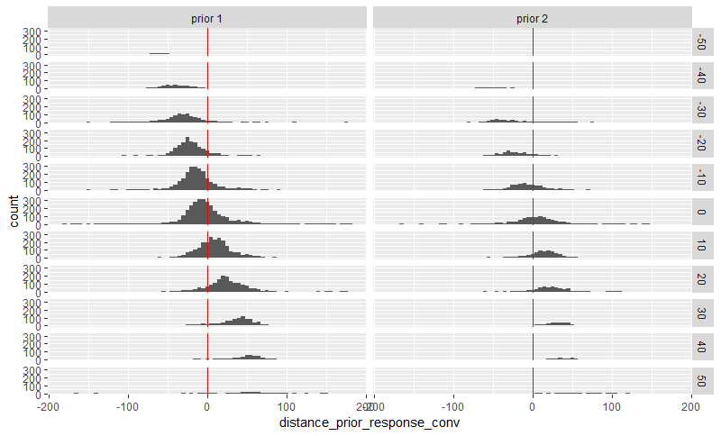
Notes:
Verdelingen zoals in Laquitaine paper

Slide 38
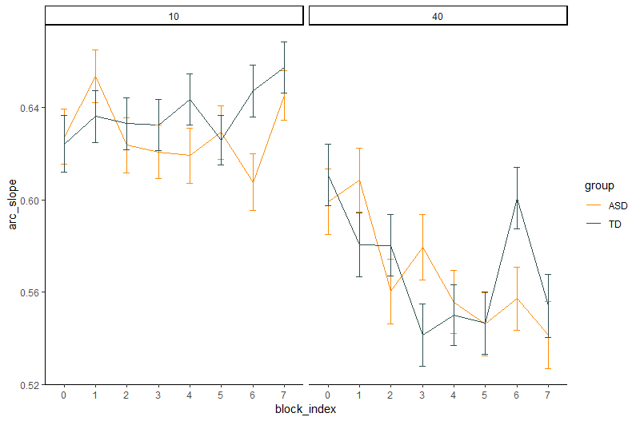
Notes:
Instantaneaous slopes per block van 50 trials, dus per 25 trials van elke conditie.

